Slide 1
Figures from Curbing Catastrophe
(Chapters One to Five)
Timothy H Dixon
University of South Florida
Tampa

Slide 2
Notes:
Figure 1.1. Number of weather-related disasters in the US whose cost exceeded $1 Billion (left hand scale), compared to the US population in millions (right hand scale). The horizontal scale shows time, for the years 1980 to 2014, the period when good data on disaster cost are available. Costs adjusted for inflation to 2015 dollars. Disaster data from National Atmosphere and Ocean Administration ( http://www.ncdc.noaa.gov/billions/). Population data from World Bank.

Slide 3
Notes:
Figure 1.2. Cost of natural disasters in the US plotted against time (years from 1980 to 2104, the same period as Figure 1.1), adjusted to 2015 dollars. A best fit line through the data is also shown. Data from NOAA.

Slide 4
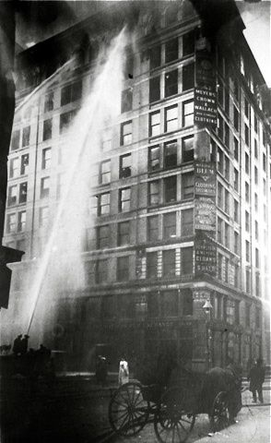
The Triangle Shirtwaist Factory Fire, 1911
Notes:
Box 2.1. The Triangle Shirtwaist Factory Fire. A shirtwaist is an old-fashioned name for a woman’s blouse, and lots of them were manufactured in New York in the early part of the 20th century. In 1911, one of the deadliest industrial accidents in US history occurred at the factory of the Triangle Waist Company in Greenwich Village. The factory occupied the top three floors of a ten-story building. When a fire broke out in a scraps pile, workers were unable to escape, because exit doors were locked, apparently to reduce the risk of theft. Managers with keys fled the fire first, dooming workers left behind. There were no fire extinguishers, and fire department ladders were too short to reach the 9th floor of the building, where most workers were trapped. A total of 146 people died, either from burns, smoke inhalation, or impacts with the street below (many workers jumped in desperation to avoid the flames). The owners of the business eventually received an insurance payment equivalent to $400 per victim, of which they eventually paid $75 as compensation to victims’ families (the owners pocketed the rest). The accident spurred improvements in workplace safety regulation, helped establish several unions, and led to the formation of the American Society of Safety Engineers, which recently celebrated its 100th anniversary.

Slide 5
Table 2.1. Top ten disasters in US history, ranked by fatalities
Year Type Property Fatalities Location
Damage
($US)
1900 Hurricane - 8,000 Galveston, Texas
1906 Earthquake - 4,500 San Francisco, California
1928 Hurricane - 4,000 Florida, Puerto Rico
2001 Terrorist attack $10B 3,000 New York, New York
1941 Military attack - 2,500 Pearl Harbor, Hawaii
1889 Dam burst - 2,200 Johnstown, Pennsylvania
1893 Hurricane - 2,000 Louisiana
2005 Hurricane $100B 1,800 New Orleans, Louisiana
1865 Ship wreck - 1,700 Memphis, Tennessee
1980 Heat wave $1B 1,700 Central, southern US
Notes:
1. Disasters include both natural and human-made events.
2. Fatality estimates are rounded to the nearest 500 for some older, less well documented events, otherwise to the nearest 100.
3. Cost estimates are available for more recent events, and are believed to be accurate to about ±50%.
4. New Orleans 2005 costs are insured costs only.

Slide 6
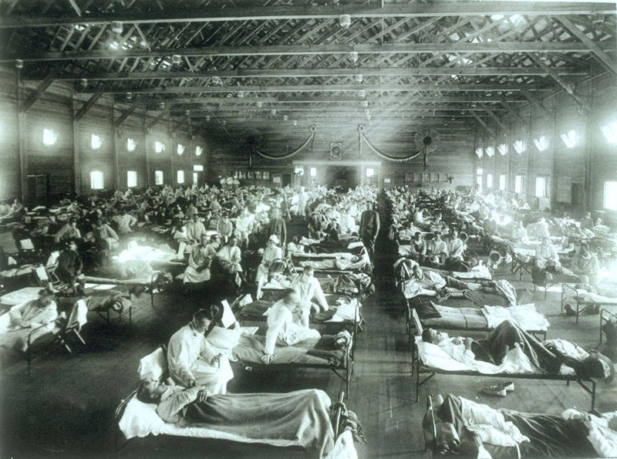
Notes:
Figure 2.1. American soldiers with influenza in a hospital ward at Camp Funston, Kansas, close to where the virus was first reported in the US, in 1918. The global pandemic was probably caused by a virus similar to the modern H1N1 virus.

Slide 7
Table 2.2. Top ten global disasters since 1970, ranked by fatalities
Year, Type Fatalities Location
1970 Storm, flood 300,000 Bangladesh
1976 Earthquake 255,000 China
2010 Earthquake 222,500 Haiti
2004 Earthquake, tsunami 222,000 Indian Ocean
2008 Cyclone Nargis 138,300 Myanmar (Burma)
1991 Cyclone Gorky 138,000 Bangladesh
2008 Earthquake 87,500 China
2005 Earthquake 73,300 Pakistan, India
1970 Earthquake 66,000 Peru
2010 Heat wave 55,600 Russia

Slide 8
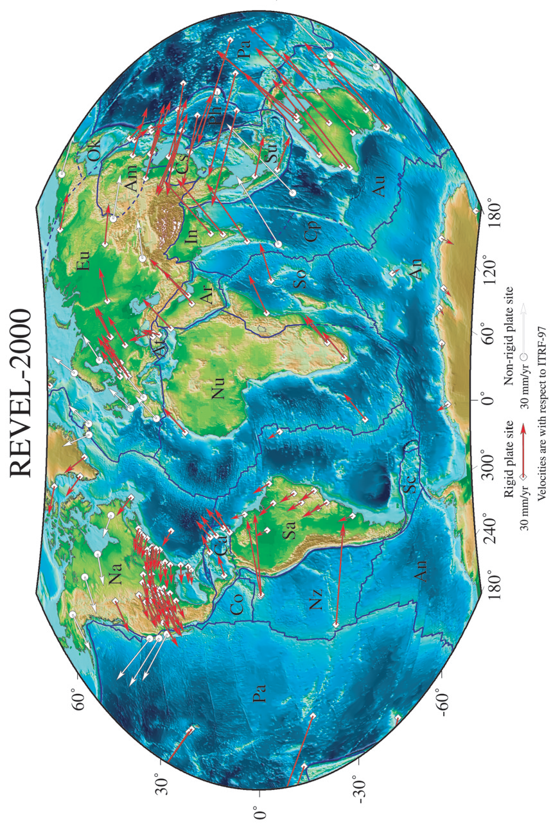
Notes:
Figure 2.2. The Earth’s major plates and their motions. The arrows show the direction of plate movement, and their length indicates speed. Plates that have significant continental crust include the Eurasian plate (Eu), the North American plate (Na) and the South American plate (Sa). The Pacific (Pa), Cocos (Co) and Nazca (Nz) plates are mainly formed of oceanic crust and lithosphere. From Sella et al. [2002].

Slide 9
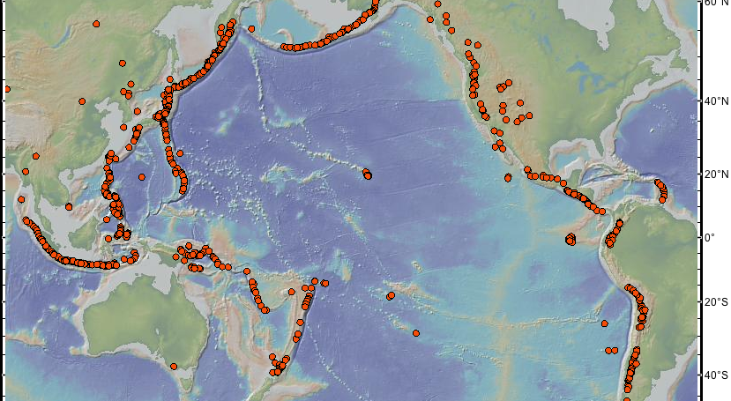
Ring of Fire
Notes:
Figure 2.3. The Pacific Ring of Fire. Many of the world’s active volcanoes (shown here with small circles) lie on or near the Pacific Rim, hence the name “ring of fire”. A map of the world’s major earthquakes would look similar. These volcanoes and earthquakes are a consequence of the geological process of subduction, which also causes Earth’s deep ocean trenches (Figure 2.4). Figure made with GeoMapApp.

Slide 10
Subduction Zone Cross Section
Notes:
Figure 2.4. Cross-section of a subduction zone, explaining the location of many earthquakes and volcanoes. “Continental crust” could represent the Canadian province of British Columbia, the US states of Washington and Oregon, or countries in Central America (e.g., Honduras) or South America (Colombia, Ecuador, Peru or Chile). “T” marks the location of the trench, a deep part of the ocean. The oceanic lithosphere subducts (is pushed and pulled) beneath the edge of the continent, in the direction of the arrow. Major earthquakes occur along part of the dipping boundary between oceanic lithosphere and the continent, marked by three X’s (see also Box 2.4). As the subducting lithosphere moves down it is squeezed by high pressure and releases fluids, causing melting of the mantle to form magma (molten rock) and volcanoes, returning large amounts of CO₂ and water to Earth’s atmosphere.

Slide 11
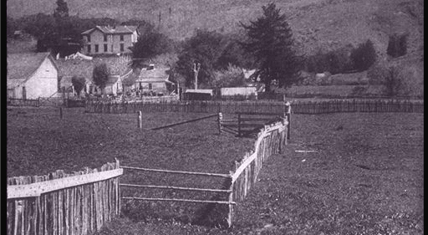
Fence offset in 1906 Earthquake
Notes:
Figure 2.5. Fence in California offset by the 1906 San Francisco earthquake. Photograph by G. K. Gilbert.

Slide 12
Stick-Slip Cycle, Vertical Fault
Notes:
Box 2.3 Stick-Slip and Elastic Rebound on a Vertical Fault. Birds eye view of strain accumulation and release over three phases of the earthquake cycle, spanning many decades. This example is for a vertical strike slip fault, the kind that ruptured in the 1906 San Francisco earthquake in California. Left hand side (1850): a fence is built across the fault many years before the earthquake. Middle (1905, one year before the earthquake): the fence has slowly deformed (strained) over the previous 55 years, reflecting movement of the plate far from the fault, and bending the rocks near the fault because the fault is stuck (locked). Right hand side (1907, one year after the earthquake): the fence as it appears shortly after the earthquake, prior to repairs. Rocks (and fence) near the fault have slipped or “caught up” with the far-field motion. Compare the right hand panel to the photograph in Figure 2.5.

Slide 13
Notes:
Box 2.4. Stick-Slip and Elastic Rebound on a Subduction Zone Fault. Three cross sections at a seismically active ocean-continent boundary (e.g, the west coast of Mexico or Central America) show the seismic cycle at a subduction zone. The process of elastic strain accumulation (stick) and release (slip) causes subduction zones to produce large earthquakes and tsunamis. The cycle can span several hundred years or longer. A (top panel - pre-seismic or interseismic stage): The downgoing plate (oceanic lithosphere, left hand side) is pushed beneath the upper plate (commonly a continent); the boundary between them is a fault. Friction on the fault causes the leading edge of the upper plate to be dragged down by the subducting plate, contributing to the formation of a deep trench between them, marked by “T”. B (middle panel - seismic stage): Eventually, the elastic strain builds to a point where frictional resistance on the fault is overcome, and the upper plate abruptly snaps back (“ruptures”). The leading edge (the underwater part) moves outward and upward, while inland portions subside. The abrupt motion stimulates damaging earthquake waves, and if the rupture reaches the surface, as it did in Sumatra in 2004 and Japan in 2011, accelerates a large volume of ocean water (greatly exaggerated here) causing a tsunami wave that can propagate across the ocean. C (bottom panel -postseismic stage): strain has been released, and the cycle begins again.

Slide 14
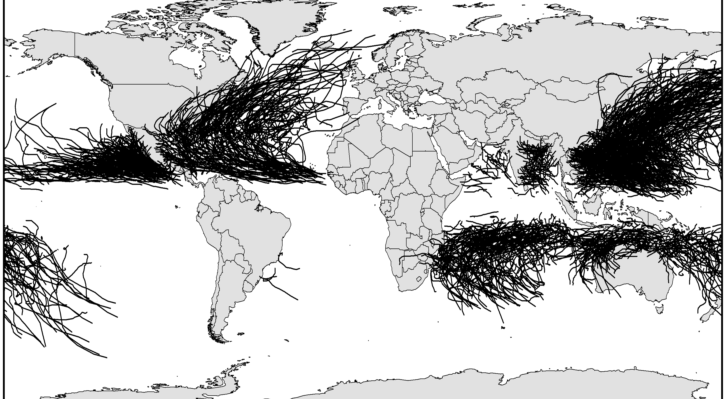
Hurricane Tracks
Notes:
Figure 2.6. Named hurricane and tropical storm tracks since the year 2000. Note the large number of tracks north of the equator in the western Atlantic (Caribbean Basin, Gulf of Mexico, eastern seaboard of the US and southeastern Canada) and western Pacific. Data courtesy of NOAA.

Slide 15
Track Location and Storm Intensity

Slide 16
Sea Level in Key West, Florida
Notes:
Figure 2.7. The height of the ocean surface (sea level) has been measured at Key West, Florida, since 1913. The measurement is made by a tide gauge, which functions much like a yard stick at the end of a dock, recording the instantaneous position of the ocean surface, but damping out wave action. This plots shows monthly averages, arbitrarily assuming that the height is zero in 1913. Since than, sea level has risen an average of about 200 millimeters (about 8 inches). A straight line fit to the data has a slope of 2.3 mm/yr (about 0.1 inch per year) indicating the rate of relative sea level rise. The ground on which the tide gauge is placed is believed to be stable, so the change represents an increase in absolute sea level, probably related to global warming. Data courtesy of NOAA and PSMSL.

Slide 17
Notes:
Figure 3.1. India was not always part of Asia. For the last 70 million years, the Indian plate has been migrating northward, and about 40 or 50 million years ago began to collide with the Eurasian plate. The resulting collision formed the Himalaya mountains along India’s northern boundary (see Figure 3.2)

Slide 18
Notes:
Figure 3.2. Example of a continent-continent collision zone. Because continental crust (India, Eurasia) is relatively light (less dense) it does not subduct easily. The leading edges of both plates crumple, with some of the crust pushed up, forming the Himalaya mountains, while denser parts are pushed down. Curved lines with single-sided arrows are faults, showing how crustal blocks are pushed up to make the mountains. Instead of a single fault separating the plates, as in Figure 2.4, the plates here are separated by multiple faults defining a broad, complex boundary zone. Because there are so many faults (simplified to just a few in this diagram) it is more difficult to assess earthquake hazard.

Slide 19
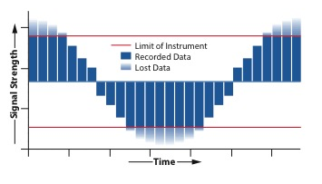
Clipping
Notes:
Box 3.1: Drift, Aliasing, and Clipping. Clipping refers to missing the peaks or valleys of a signal, usually because the signal is too strong for the design of the instrument (think of cheap speakers that distort when the music gets too loud). The principle is shown in the figure above. The signal in this example is a simple wave, with both highs and lows, but the maximum signal is missed (“clipped”) because the instrument is only capable of recording signals to the limit of the upper horizontal line. Similarly, the minimum signal size is missed because the instrument lacks sufficient sensitivity. Seismometers for measuring earth motion during an earthquake tend to clip at the upper end if they are located near the earthquake source, where shaking is strong. This initially made it difficult to design buildings to survive earthquakes. Until strong motion sensors came along (basically, seismometers that don’t clip large signals) engineers didn’t know how strong ground shaking actually was close to an earthquake. Some of the radiation sensors deployed near the Fukushima nuclear plant in Japan similarly went off scale during the disaster, meaning that the maximum levels of radiation released during the accident are poorly known (see Chapter Four). (For Aliasing, see Appendix).

Slide 20
Notes:
Figure 3.3. Corruption versus individual wealth for the nations mentioned in this book. Corruption is measured by the Corruption Perception Index (CPI), based on interviews with business people doing business in that country. CPI varies from 0 (very corrupt) to10 (very clean). Wealth is measured by Gross Domestic Product per person. Data from Transparency International (www.transparency.org) and the United Nations, illustration prepared by the author.

Slide 21
Notes:
Figure 3.4. Plate tectonic setting of Haiti and the island of Hispaniola. The island lies within a complex boundary zone between the North American plate (roughly the top half of the map) and the Caribbean plate (roughly the bottom half of the map). A network of faults (only the major ones are shown here) separates the two plates.

Slide 22
Table 4.1. Ten largest earthquakes in the last 110 years
Location Year Magnitude
Chile 1960 9.5
Sumatra 2004 9.2*
Alaska (Prince W’m Snd) 1964 9.2
Japan 2011 9.0
Kamchatka 1952 9.0
Chile 2010 8.8
Ecuador-Colombia 1906 8.8
Alaska (Rat Island) 1965 8.7
Sumatra (North) 2005 8.6
Tibet-Assam 1950 8.6
* Estimates range from 9.1 to 9.3

Slide 23
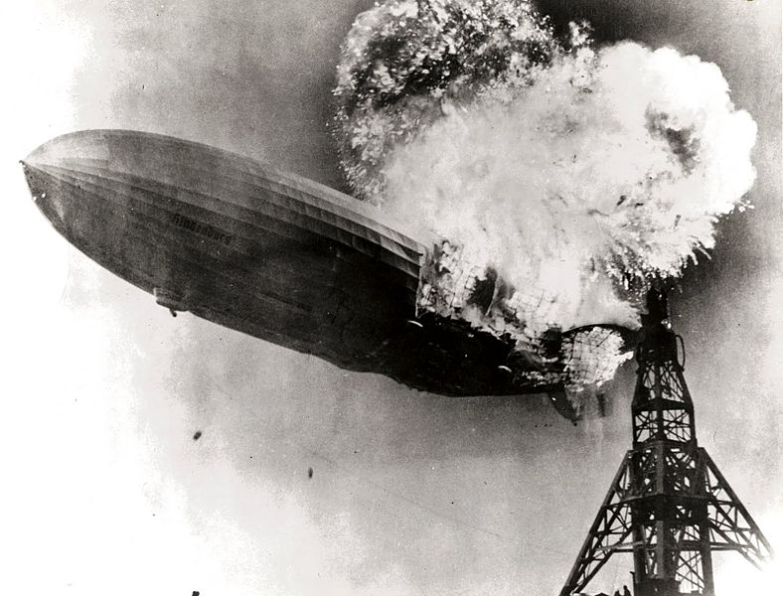
The Hindenburg Disaster, 1937

Slide 24
Hypothetical Trench Cross Section,
Showing Earthquake Offset
Notes:
Figure 4.1. Hypothetical and simplified cross section of the vertical wall of a trench dug for paleoseismology research. A fault (a fracture in the earth that accommodates differential motion, usually via earthquakes) has displaced an older sedimentary layer (B) but not a younger layer (A). The exact time of the earthquake that produced the fault offset is not known, but is probably close to the time of deposition of a thin layer, E, called the Event Horizon. Ideally the age of E can be determined. If not, charcoal in units B (5000 years old) and A (3000 years old) is datable by radiocarbon techniques. Ignoring uncertainty in the radiocarbon dates, this suggests that the earthquake occurred 4,000 plus or minus 1000 years ago.

Slide 25
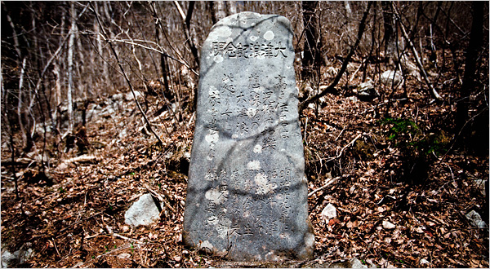
Tsunami Stones
Notes:
Figure 4.2. Tsunami stones – historical evidence for large tsunamis in northeastern Japan. The run-up heights of tsunamis of 1896 (Sanriku earthquake) and perhaps the 869 (Jogan earthquake) may be marked by these stones. The stone engraving says “Do not build your homes below this point.” Photograph by Ko Sasaki, reprinted courtesy the New York Times/Redux.

Slide 26
Table 4.2: Large Historical Tsunamis in or near the Tohoku Region
Year Maximum Run-Up Height (m) Reference
869 ? (similar to 2011?) 1
1611 25 2,3
1896 38 2,3
1933 27 2,3
2011 40 3
References:
1. Minoura et al. [2001]
2. Watanabe [1998]
3. Nöggerath et al. [2011]

Slide 27
Notes:
Figure 5.1. Sketch map of the Cascadia subduction zone. The Juan de Fuca plate, offshore the states of Washington and Oregon and the Canadian province of British Columbia, moves northwest at about 4 cm/yr, subducting (pushing beneath) beneath the west coast of North America. The smaller Gorda plate to the south and Explorer plate to the north also subduct. The heavy line with teeth marks the subduction boundary between the plates and the approximate location of the sediment-filled trench.

Slide 28
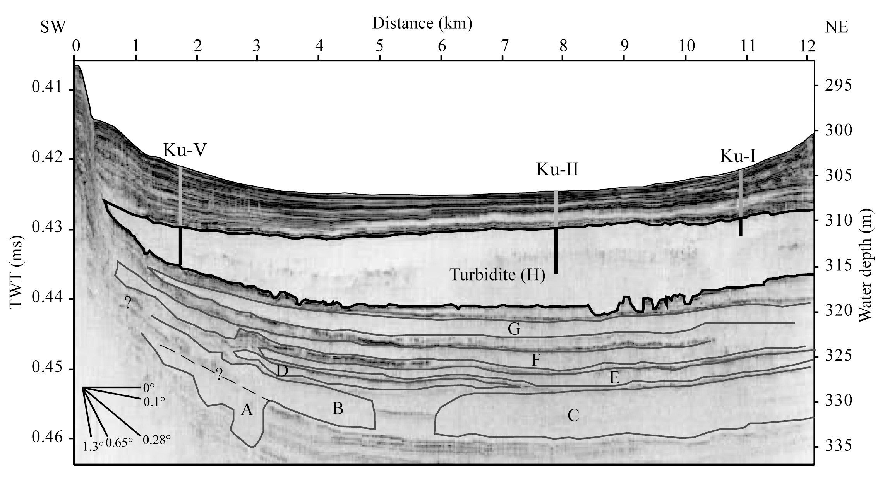
Notes:
Figure 5.2. A seismic cross section (Box 5.1) from Lake Geneva in Switzerland, from work by Katrina Kremer and colleagues at the University of Geneva. The cross section covers a distance of 12 km (about 7.5) miles). The vertical scale is depth, estimated from the two way travel time (TWT) of the acoustic signal in milliseconds (1 ms = 1 thousandth of a second). Water depth here is about 300 meters (1100 feet). The lens-shaped unit labeled H is a deposit known as a turbidite (see Box 5.2) caused by a large landslide and tsunami in 563 AD that destroyed a town at the western end of the lake where the modern city of Geneva is now located. The tsunami was probably caused by an underwater landslide from the Rhone River delta at the eastern end of lake, when the delta slumped abruptly into deeper parts of the lake, forming the turbidite (see next section, Tsunamis in Switzerland). Vertical lines mark the location of drill cores used to recover sediment samples for later study and dating. Similar units below the youngest turbidite deposit are labeled A through G, and tend to be thinner, in part because of sediment compaction. These older units suggest that tsunamis have occurred repeatedly in the past. Figure courtesy of K. Kremer (personal communication). See Kremer et al. [2012, 2014].

Slide 29
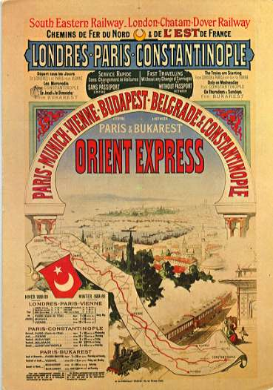
Notes:
Figure 5.3. An early advertisement for the Orient Express.

Slide 30
Notes:
Figure 5.4. The North Anatolian Fault represents the northern boundary between the Anatolian plate and the Eurasian plate. The thick arrows show the approximate direction of movement of the various plates in the region (African, Arabian, and Anatolian) relative to the Eurasian plate. Note that Istanbul lies close to the North Anatolian Fault. McClusky et al. [2000] and Uzel et al. [2010] give additional details.

Slide 31
Notes:
Figure 5.5. Map of the North Anatolian fault, showing rupture locations of large earthquakes on this fault during the last century. Note location of Istanbul. Large earthquakes are defined as those having more than 2 meters of slip, using the data of Pondard et al. [2007].

